Slide 1
A Flexible Framework for Communication-Efficient Machine Learning
AAAI’21
Presented by,
Pavana Prakash
Sarit Khirirat¹, Sindri Magnusson², Arda Ayetekin³, Mikael Johansson¹
¹KTH Royal Institute of Technology
²Stockholm University
³Ericsson, Sweden.

Slide 2

Outline
Motivation
Compression: methods and justification
Theoretical results
Numerical experiments and discussion
Conclusion

Slide 3
Distributed Machine Learning
State-of-the-art problems have large dimension d (millions of parameters).
64 × d communicated bits per iteration per node.
Performance bottleneck has shifted from computation to communication!
Neural network training: communication dominates 80% of run time

Slide 4
Strategies to Reduce Communication Bottleneck
Asynchronous computation
Client sampling
Communication period to update global parameters
Compression

Slide 5
Compression Methods for Reducing Communications
Compression Q(·) can be
Sparsification: send only most important gradient elements.
Quantization: reduce precision on elements (e.g., sign compression).

Slide 6
Gradient Compression Methods
Gradient compression in distributed learning

Slide 7
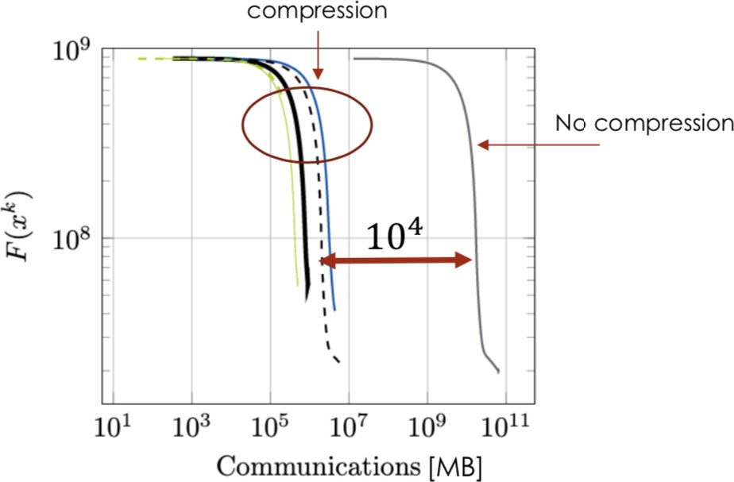
Gradient compression works well in practice
Distributed data: server (Ericsson Kista) 500 km away from the data (Lund).
×1000 communication saving, compared to full-precision algorithms.

Slide 8
Lack of theoretical justification for gradient compression
Communication complexity grows at least linearly with d .
In the worst case, compression does not improve efficiency!

Slide 9
Challenges
Communication benefits are often realized after a careful tuning of the compression level before training
Most existing compression schemes are agnostic of the disparate communication costs for different technologies
No universally good compressor that works well on all problems (worst-case communication complexity of any optimization methods)
Worst-case bounds do not explain communication efficiency improvements.
Communication efficiency achieved by hyperparameter optimization.

Slide 10
Contributions
Explain efficiency by data/problem dependent complexity bounds.
Design adaptive compression algorithms that
maximize communication efficiency automatically
adjust to data on-line and communication technology used i.e.,
Find a good balance between the communication savings and suboptimality guarantees of the solution
Focus on adaptive compression,
Strikes this balance by adjusting the compression level online, e.g.
by optimizing the transmitted bits per iteration.

Slide 11
Initial Setting: Sparsified Gradient Descent
Consider sparsified gradient descent
where QT (·) with sparsity budget T is defined by
where IT (g) has T indices of components with the largest absolute magnitude.

Slide 12
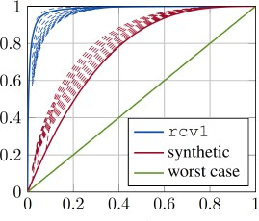
Why does sparsification improve communication efficiency?
Worst Case: Gradient energy is distributed evenly among all components.
α(T ) = T/d.
Real (sparse) Data: Gradient energy is concentrated on few components.
α(T ) ≥ T/d.

Slide 13
Sparsified Gradient Descent: Descent Lemma
α(T) implies the progress sparsification methods can make in each iteration.
Classical gradient descent lemma when α(T) = 1.
α(T ) ≥ T /d (with equality for the worst-case energy distribution).

Slide 14
Sparsified Gradient Descent: Data-dependent Complexity
From the descent lemma, the data-dependent iteration complexities are derived
where α(T ) ≥ α¯Data.

Slide 15
Sparsified Gradient Descent: Data-dependent Complexity
From the descent lemma, the data-dependent iteration complexities are derived
where α(T ) ≥ α¯Data.

Slide 16
Why does sparsification improve communication efficiency?

Slide 17
Adaptive gradient compression
Main Idea: Find sparsity budget T that maximizes descent per iteration, i.e.
α(T)/Cost(T) attains its minimum over T = 1, 2, . . . , d.
α(T) and Cost(T) easily measured online.
α(T) adapted to compression used.
Cost(T) adapted to technology or application.

Slide 18
Communication Cost: Bits, Packets, Energy and Beyond
Cost(T) →
For example, if we just count transmitted bits (c₁ = 1), then a single UDP packet transmitted over the Ethernet requires an overhead of,
c₀ = 54 x 8 bits and can have a payload of up to 1472 bytes.
communication overhead
cost of transmitting a single payload byte
number of payload bits per packet
payload

Slide 19
Communication Adaptive Tuning (CAT) Algorithms
At iteration k = 0, 1, 2, . . .
Step 1 (Adaptive tuning):
tune T adaptively to optimize the communication efficiency
hyper-parameter optimization not required
Step 2 (Compressed gradient):

Slide 20
Extensions of Communication Adaptive Tuning (CAT)
Sparsification and Quantization (S+Q).
Stochastic Sparsification (for stochastic, multi-node optimization).
where

Slide 21
Communication Costs
Many Possibilities:
Bits, energy, transmission time etc.
Build from protocols/standards
Build from empirical measurements
Affine cost: Cost(T) = c₀ + c₁T
c₀ packet header, c₁ cost per entree
Floats over Ethernet c₀ = 54, c1 = 4 + log2(d)
Empirical Measurements (see figure)
Packet cost: Ethernet
IEEE 802.15.4 (low energy wireless)
Communication times (s)

Slide 22
Experiment Settings
CAT framework for dynamic sparsification and quantization (S+Q)
Single node: single-master, single-worker setup
URL data set with 2.4 million data points and 3.2 million features
Distributed data: server (Ericsson Kista) 500 km away from the data (Lund)
1000 Mbit Internet connection using ZMQ library

Slide 23
Single-node Architecture
Communication time (ms)
CAT S+Q outperforms GD and Alistarh’s S+Q up to two orders and one order of magnitude, respectively, in communication efficiency.

Slide 24
Experiment Settings – multi-node
CAT framework on
deterministic sparsification (SG)
stochastic sparsification (SS)
Sparsification with quantization (S+Q)
RCV1 data set : 47,236 features, and 697,641 data points.
Wireless communication scenario (e.g, IEEE 802.15.4) with 512 byte packets.
Multi-node: 4 nodes using MPI, splitting the data evenly between the nodes.

Slide 25
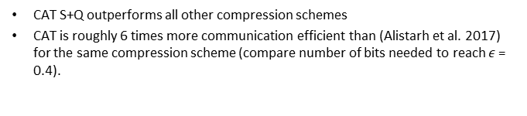
Multiple-node Architecture
Communications (bits)
CAT S+Q outperforms all other compression schemes
CAT is roughly 6 times more communication efficient than (Alistarh et al. 2017) for the same compression scheme (compare number of bits needed to reach $ε$ = 0.4).

Slide 26
Open Problems
CAT for federated optimization
CAT for error feedback, etc.

Slide 27
CAT Frameworks for Distributed Architectures
Limitations:
CAT with the same compression level T for all clients.

Slide 28
CAT Frameworks for Distributed Stochastic Sparsification
Questions:
How to tune local compression level without synchronization?
How to tune deterministic compression for federated architectures?

Slide 29
Conclusions
Existing Works:
Worst-case bound does not explain communication efficiency by compression.
Compressions not adapted to technology or relevant communication costs.
Contributions:
Explain improved efficiency by data/problem dependent complexity.
Design adaptive compression that
optimizes overall communication efficiency automatically.
adjusts to data online and to any communication technology/application used.
leads to significant communication savings, compared to existing compression.
Open Problems: CAT frameworks for distributed and federated optimization

Slide 30


THANK YOU
Pavana Prakash
Department of Electrical and Computer Engineering
University of Houston
Houston, TX

